Slide 1
Object
Lecturer: Ngo Huy Bien
Software Engineering Department
Faculty of Information Technology
VNUHCM - University of Science
Ho Chi Minh City, Vietnam
nhbien@fit.hcmus.edu.vn

Slide 2

Objectives
To present what is an object.
To identify and describe objects.
To create classes, attributes and methods.
To create objects (instances).
To present why use objects.
To present what is abstraction.
To present why use abstraction.
To create static classes, attributes and methods.
To store and retrieve object data using files.

Slide 3

Contents

Slide 4

References
Jim Keogh and Mario Giannini. OOP Demystified: A Self-Teaching Guide. 2005.
Tom Archer and Andrew Whitechapel . Inside C#. 2002.
Matt Weisfeld (2013). The Object-Oriented Thought Process. Pearson Education.
Stephen Prata. C++ Primer Plus. 6th Edition. 2012.
Stephen Prata. C Primer Plus. 2014.
S. George and C. V. Quarman. Java Programming. 2011.
Bertrand Meyer. Object Oriented Software Construction 2nd Ed. 1997.
Grady Booch et al. Object Oriented Analysis and Design with Application. 3rd Edition. 2007.

Slide 5
How Do We Write a Program?
Inputs
Algorithm
Outputs
Inputs
Main Function
Outputs

Slide 6
Our Main Function is Too Big
Inputs
Main Function
Outputs
Function 1: variable f1a, variable f1b
Function 5: variable f5a, variable f5b
Main Function: variable m1, variable m2
Function 4
Function 4()
Function 2()
Function 1()
Function 3()
Function 2: variable f2a, variable f2b
Function 3

Slide 7
So, What are the Problems?
Function 1: variable f1a, variable f1b
f1a = m1*2
Function 5: variable f5a, variable f5b
Main Function: variable m1, variable m2
Function 4
f4a = m1*m1
Function 4()
Function 2()
// Function2 can only be called after Function1 is finished.
Function 1()
Function 3()
// This function modifies m1 and it affects Function 4
Function 2: variable f2a, variable f2b
f2a = m1/4
Function 3
m1 = 6

Slide 8
Okay, We Can Fix It
Function 1: variable f1a, variable f1b
f1a = n1*2
Function 5: variable f3a, variable f3b
Main Function: variable m1, variable m2
Function 4
Function 4(m1)
Function 2()
Function 1()
Function 3(m1)
Function 2: variable f2a, variable f2b
f2a = n1/4
Function 3
m1 = 6
Function12(n1)
Function12(m1)
Function3 (n2)
Function4 (n3)

Slide 9
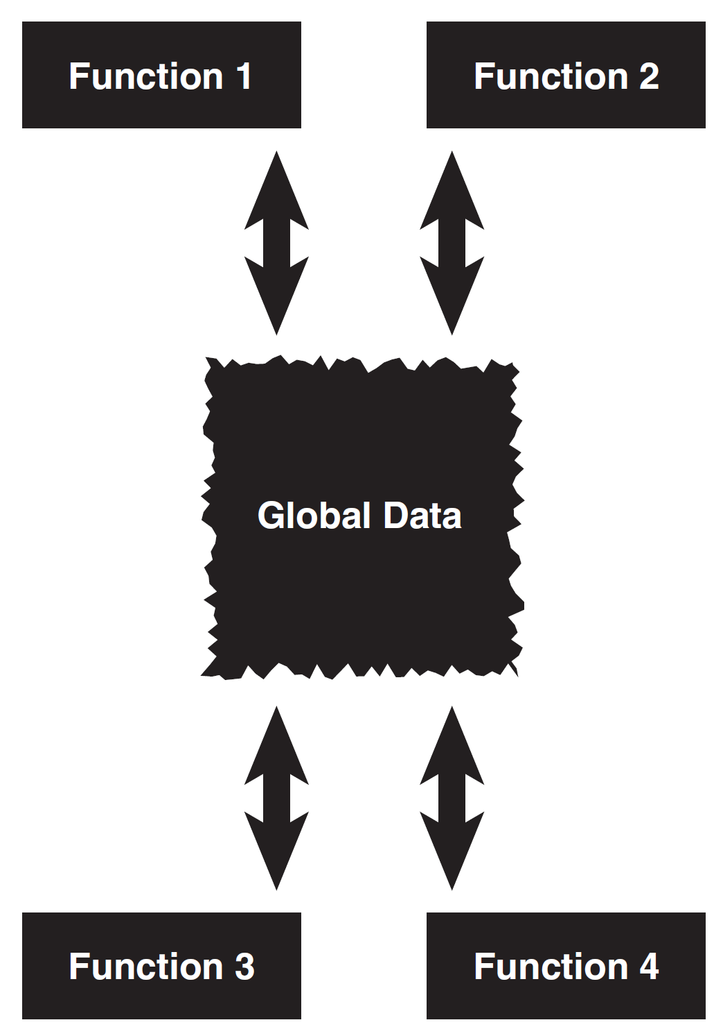
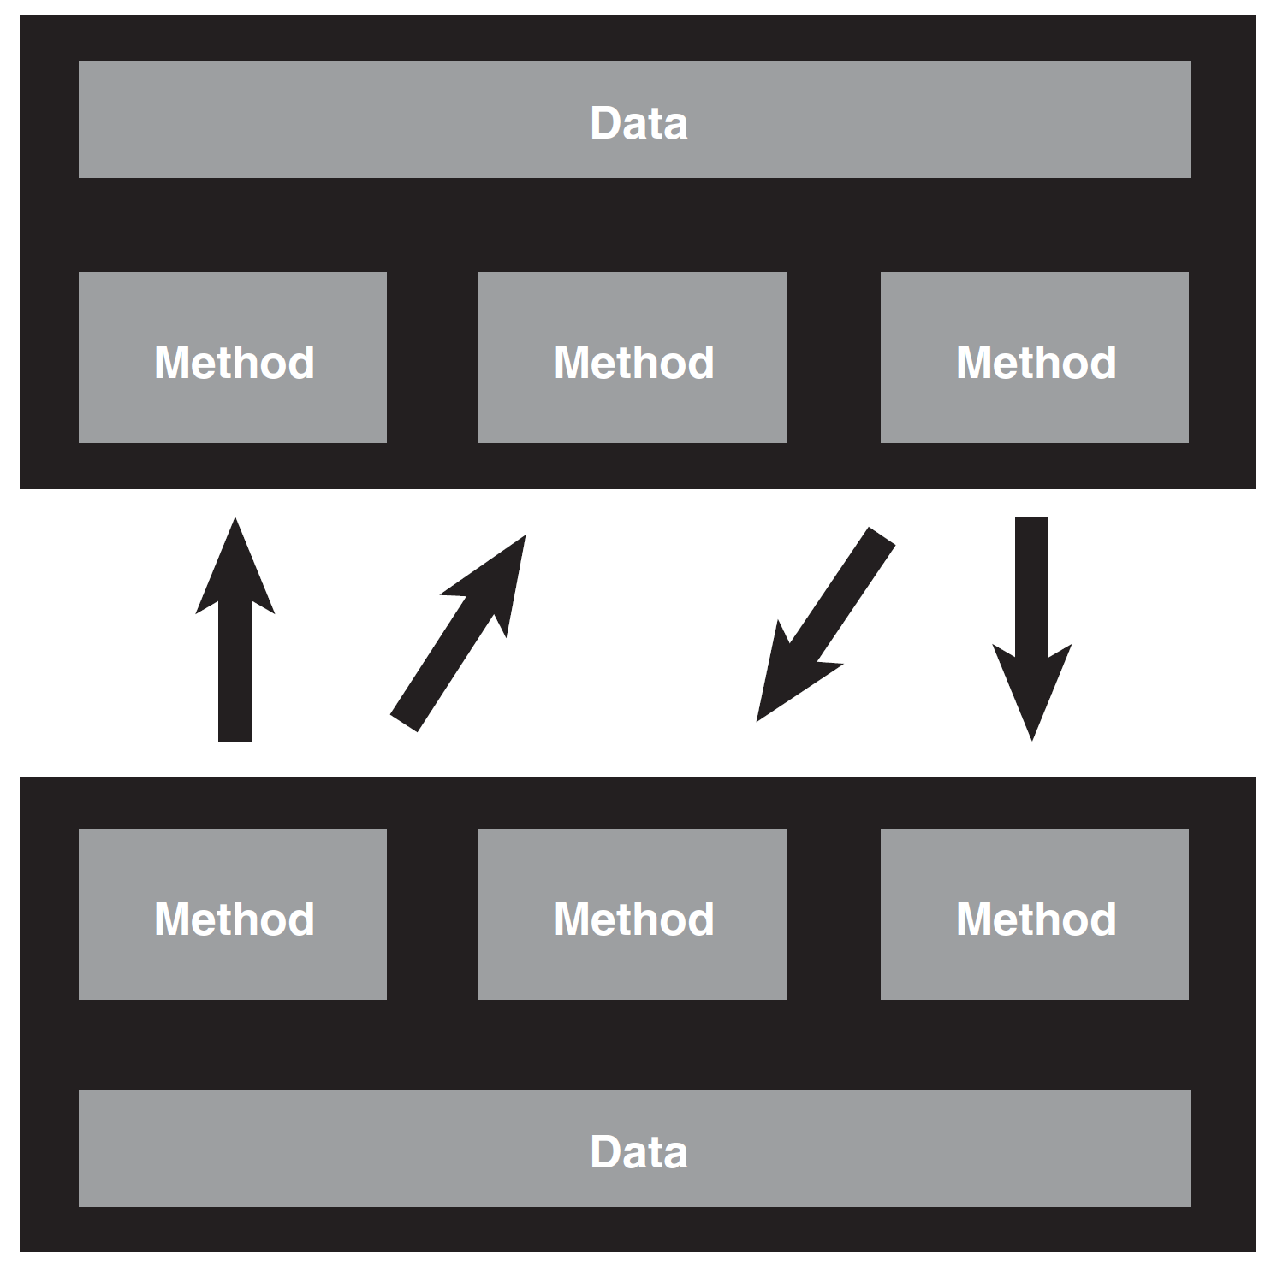
What Have We Done? [3]

Slide 10

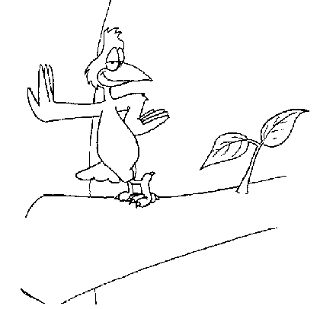
Object [1]
What is an object? – Independent entity which can be treated in isolation of all other objects.
States
– Good mood
– Asleep
Attributes:
– Full name
– Age
Behaviors
– Eat
– Breath
– Walk
Data
– First name
– Last name

Slide 11

So, How Do We Write a Program?
Inputs
Main Function
Outputs
Function 1: variable f1a, variable f1b
Function 5: variable f5a, variable f5b
Main Function: variable m1, variable m2
Function 4
Function 4()
Function 2()
Function 1()
Function3()
Function 2: variable f2a, variable f2b
Function 3

Slide 12

Identifying and Describing Objects
Again,
What
Are
The
Inputs?
Identifying attributes: name, address, telephone number…
Describing an attribute: name and value of the attribute
Decomposing the attribute to data: first name, last name, street address, city…
Identifying behaviors: study, take exam, eat…
Describing behavior: input data, steps, output data…
– Name: Study
– Input data: course name
– Step 1: attend class, record lecture.
– Step 2: read books at home
– Step 3: do exercises
– …
– Output data: good, normal, bad result

Slide 13
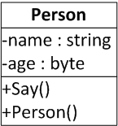
How Do We Describe An Object Formally? – Use a Class [2]
What is a class? – Template for object creation.
Attributes
Method
Constructor
Instance – Runtime entity
Message – communication mechanism between objects
Access members - dot notation (.)

Slide 14

A Complete Program
Class
Entry point
Instance
Message

Slide 15
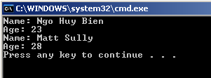
Constructor
Special method that is called whenever an instance of the class is created.
<class> <object> = new <class>(constructor arguments)

Slide 16

Destructor
A method that’s called when an object is destroyed or goes out of scope.

Slide 17
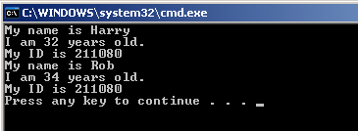
Field and Method
A field is a member variable used to hold a value.
A method is the actual code that acts on the object’s data (or field values).

Slide 18
Property – Aka Smart Field
A property consists of a field declaration and accessors used to modify that field’s value.

Slide 19
Auto-Implemented Properties
https://learn.microsoft.com/en-us/dotnet/csharp/programming-guide/classes-and-structs/auto-implemented-properties
public string FirstName { get; set; } = "Jane";
public int DeleteFileAfter { get; set; } = (int)30;
public bool EnableDeletion { get; set; } = false;

Slide 20
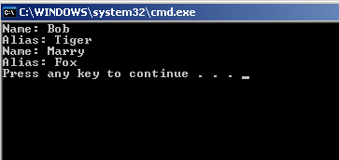

Self Reference
The this keyword refers to the current instance of the class.

Slide 21
Again, Why Use Objects?
Function 1: variable f1a, variable f1b
f1a = n1*2
Function 5: variable f3a, variable f3b
Main Function: variable m1, variable m2
Function 4
f4a = m1*m1
Function 4()
Function 1()
Function 1()
Function 3()
Function 2: variable f2a, variable f2b
f2a = n1/4
Function 3
m1 = 6
Class C {
A1
Function () }
c1.A1 = 100
c1.Function()

Slide 22
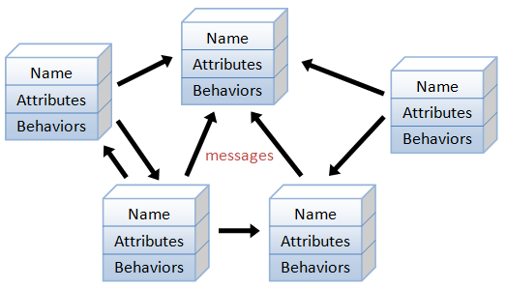
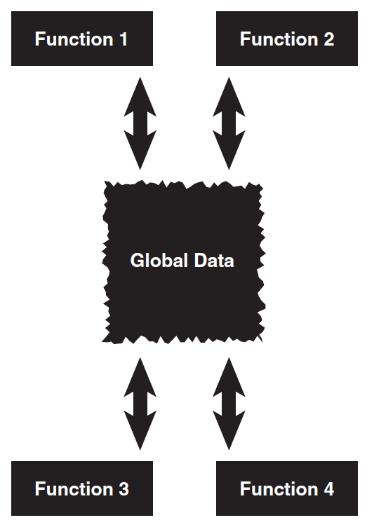
A Solution for Complexity
They allow us to break down our system into granular boxes, no matter how big our system is.
When we declare a class, we automatically create an abstraction layer.

Slide 23
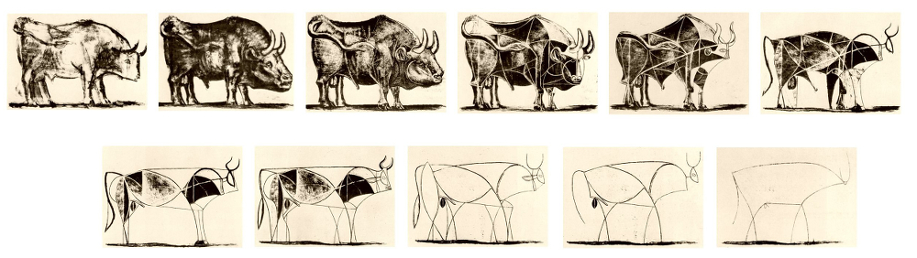
What is Abstraction? [8]
An abstraction denotes the essential characteristics of an object that distinguish it from all other kinds of objects and thus provide crisply defined conceptual boundaries, relative to the perspective of the viewer.
The selection of significant attributes is abstraction.
Abstraction is a simplified description, or specification, of a system that emphasizes some of the system’s details or properties while suppressing others.

Slide 24
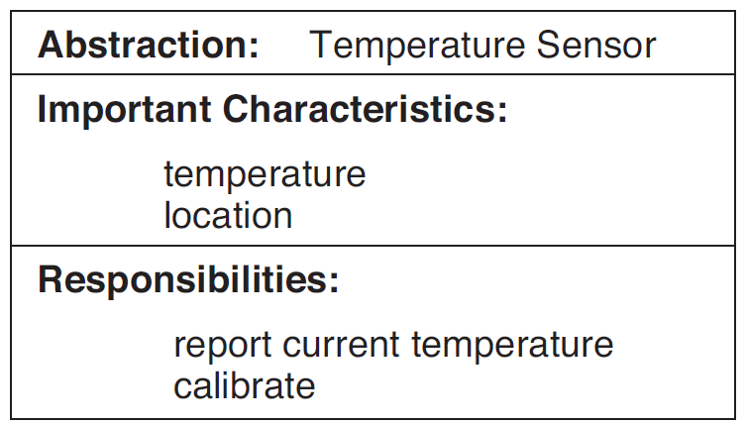
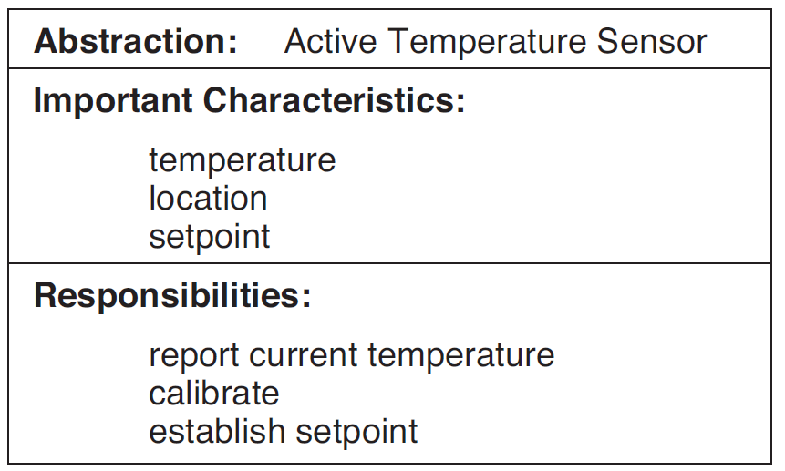
Examples of Abstraction
How the Active Temperature Sensor carries out its responsibilities is a function of its inside view and is of no concern to outside clients.
These then are the secrets of the class, which are implemented by the class’s private parts together with the definition of its member functions.

Slide 25
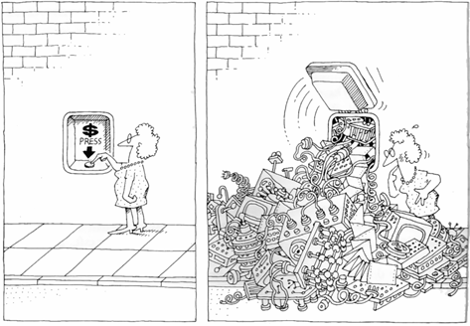
Why Abstraction?
Abstraction is one of the fundamental ways that we as humans cope with complexity.
The task of the software development team is to engineer the illusion of simplicity.

Slide 26
But, Why Don’t We Just Use Libraries?
Function 1: variable f1a, variable f1b
f1a = n1*2
Function 5: variable f3a, variable f3b
Main Function: variable m1, variable m2
Function 4
f4a = m1*m1
Function 4()
Function 1()
Function 1()
Function 3()
Function 2: variable f2a, variable f2b
f2a = n1/4
Function 3
m1 = 6
Library L {
Struct S1
Function () }
S1 s1;
s1.x = 100;
Function(s1);

Slide 27
Function 1: variable f1a, variable f1b
f1a = n1*2
Function 3: variable f3a, variable f3b
n1 = 100 // Function’s requirement
Main Function: variable m1, variable m2
Function 4
Function 5()
Function 1()
Function 4()
Function 2()
Function 2: variable f2a, variable f2b
f2a = n1/4
Function 3
m1 = 6

Slide 28
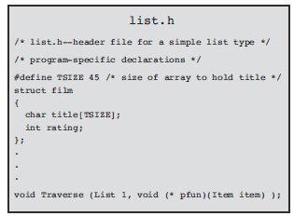
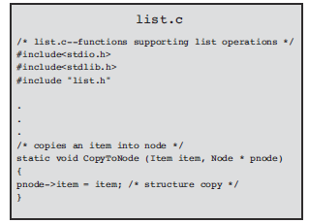
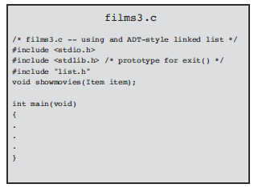

C Library Example [4]

Slide 29


Another Reason: Bottom-up Development [7]
A top-down process
A bottom-up process of building robust and extendible solutions to parts of the problem, and combining them into more and more powerful assemblies — until the final assembly which yields a solution of the original problem

Slide 30
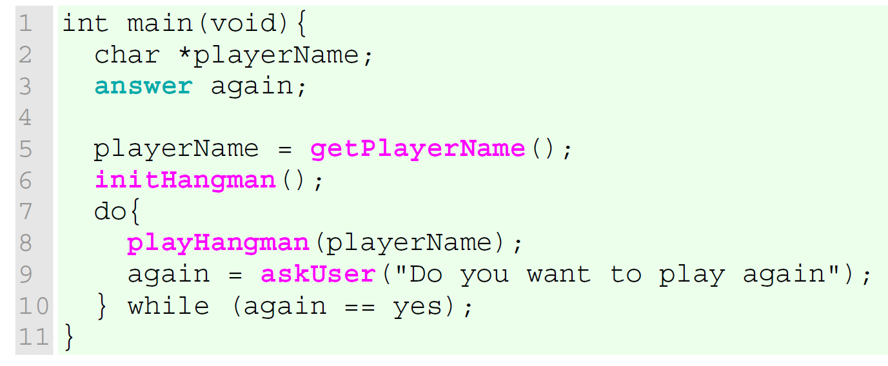
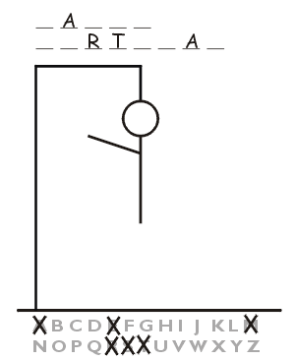
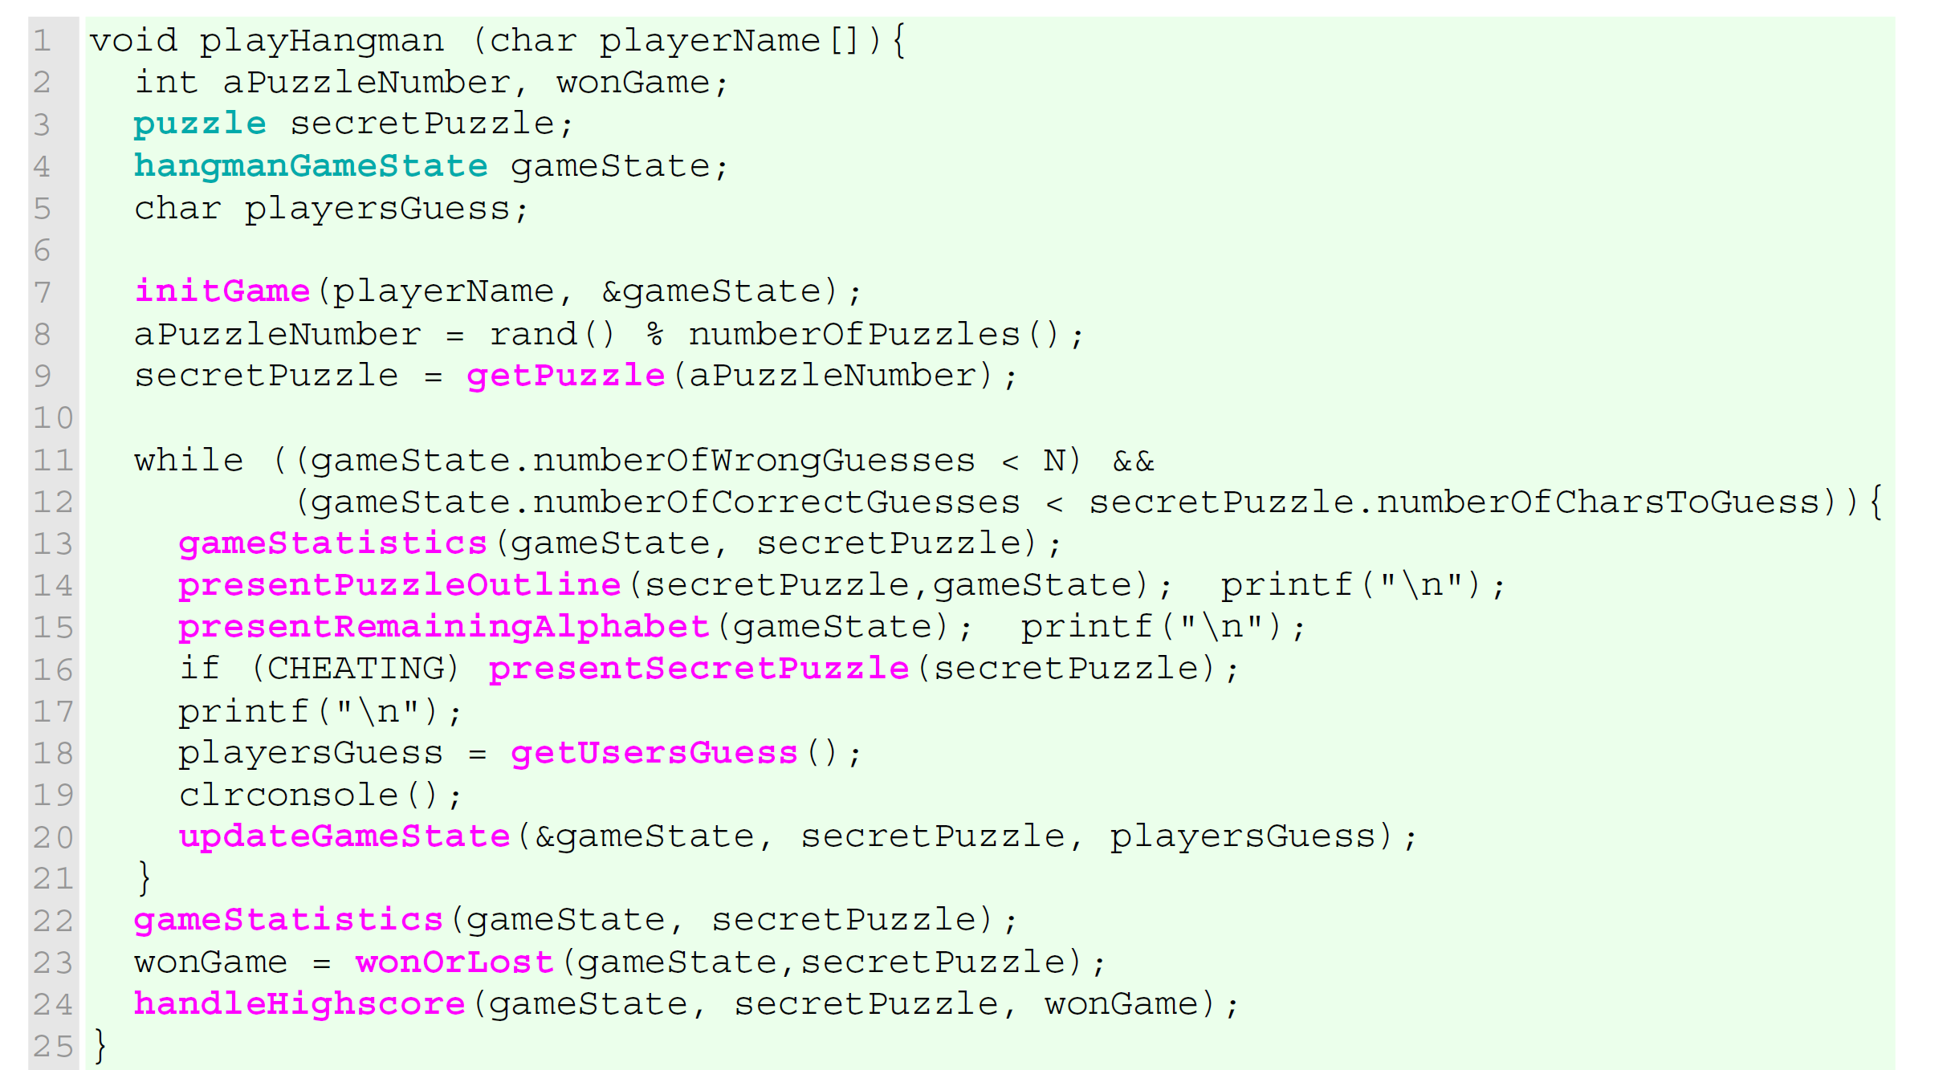
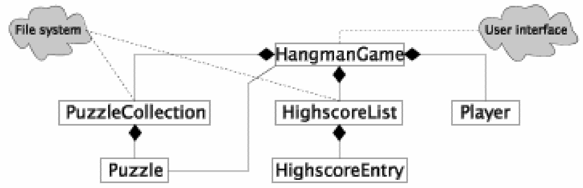
An Example

Slide 31


Slide 32

Static Constructor
Static constructor cannot take arguments, cannot be public
Static constructor is called only once

Slide 33
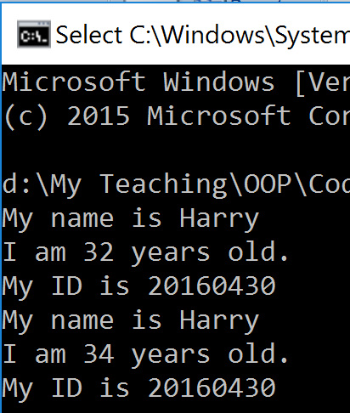
Static Field
A static field is a field that exists in a class as a whole, rather than in a specific instance of the class.

Slide 34
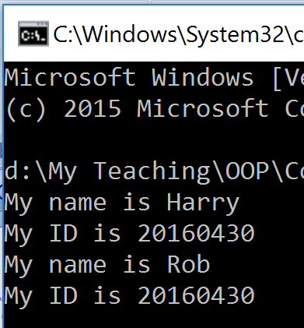
Static Method
A static method is a method that exists in a class as a whole, rather than in a specific instance of the class.

Slide 35
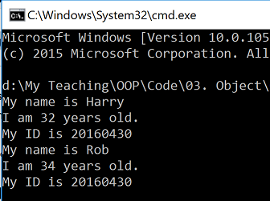
Static Class
Class that is used simply to group together a collection of utility methods.
The class cannot have instance variables or methods.

Slide 36
Is Static “Bad”?
Is static field bad?
Static variables represent global state. So…
Is static method bad?
Static method can only access static fields. So…
What if I don’t use static fields in my static method? – Okay, then…
Is static class bad?
A static class is just a group of methods. So…

Slide 37
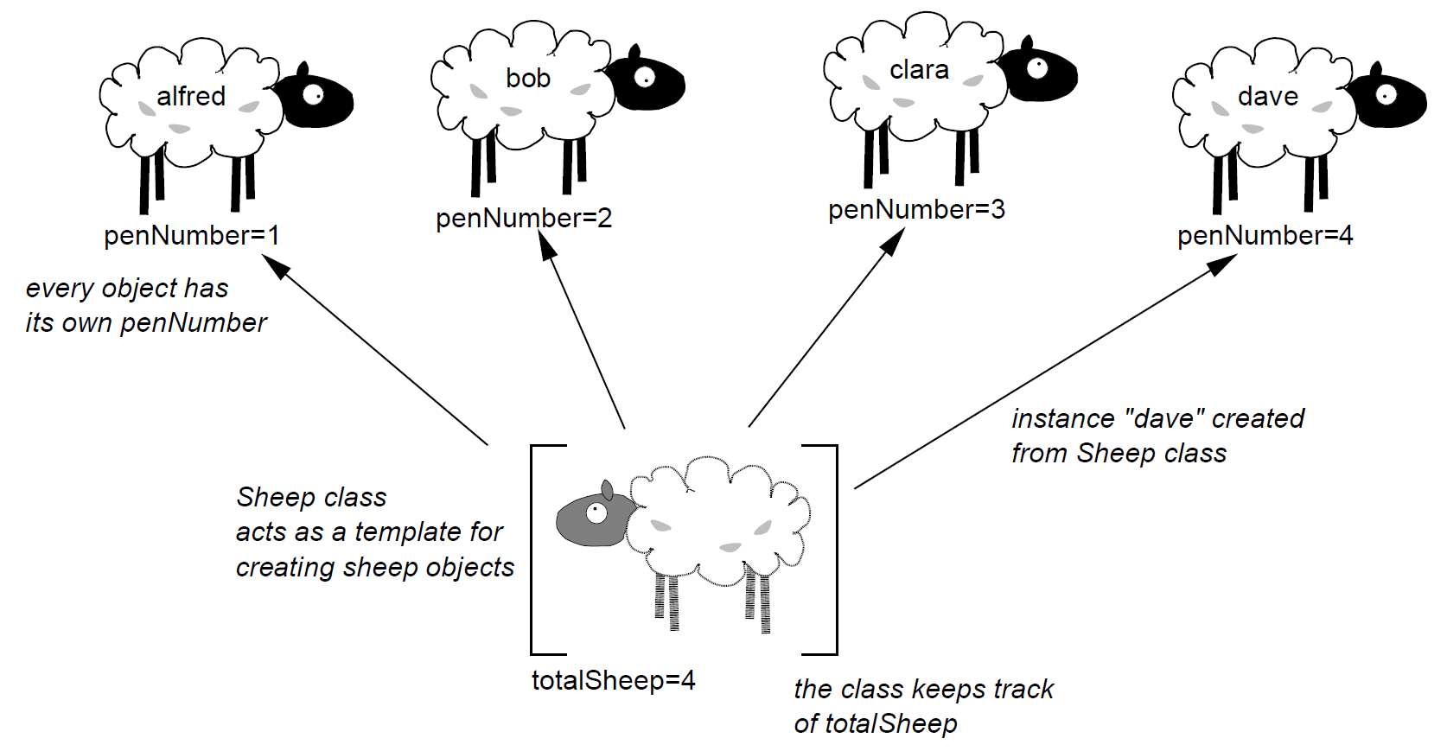
Exercise [6]
Say you have a farm and keep sheep.
You have several pens in which the sheep are kept so each sheep is assigned a pen number.
You may wish to find out which pen a sheep is in, move it to another pen, or count the total number of sheep that you own.

Slide 38

Static Read Only Field
A static readonly field can be assigned to only in a static constructor or a variable initializer.

Slide 39

Indexers
How to quickly access an element of an array inside an object?
– Treat an object like an array.
An indexer is a member that enables an object to be indexed in the same way as an array.
Defining a C# indexer is much like defining properties.

Slide 40


Immutable and Mutable Object
Internal state of immutable object cannot be changed.
Internal state of mutable object can be changed.

Slide 41
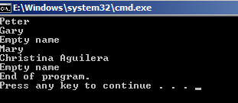
using Statement
The using statement obtains the resource specified, executes the statements and finally calls the Dispose method of the object to clean up the object.

Slide 42
Object Initializers
public class WidgetRecipient
{
public String Name { get; set; }
public String Email { get; set; }
}
IList<WidgetRecipient> recipients = new List<WidgetRecipient>();
recipients.Add(new WidgetRecipient { Name = "--Select Recipient--", Email = String.Empty });
if (!String.IsNullOrEmpty(this.GeneralEmail))
{
recipients.Add(new WidgetRecipient { Name = this.GeneralEmailLabel, Email = this.GeneralEmail });
}

Slide 44
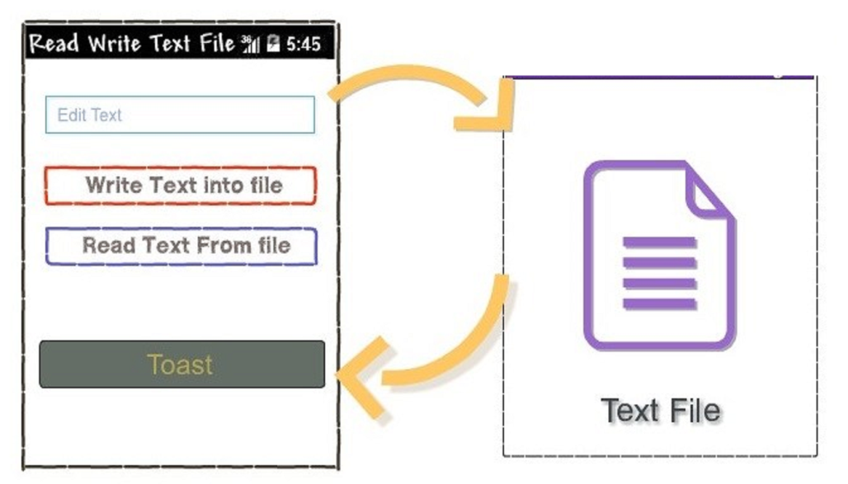
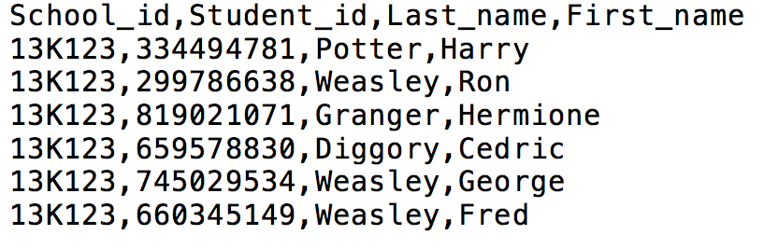
How To Store And Retrieve Object Data?

Slide 45
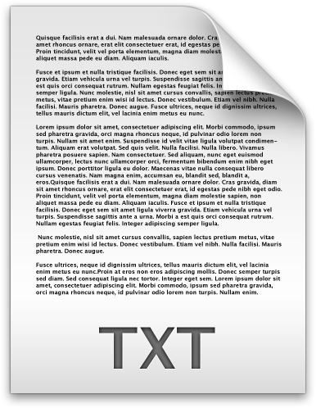
.NET File I/O
Create a file
Write out an array of bytes
Read an array of bytes
Close the file

Slide 46
Creating a File
public static void Main(string[] args)
{
byte[] buffer = new Byte[]
{76,101,116,32,116,104,101,114,101,
32,98,101,32,108,105,103,104,116};
FileStream fileStream = new FileStream("Foo.txt", FileMode.Create);
fileStream.Write(buffer, 0, buffer.Length);
fileStream.Close();
}

Slide 47
Writing a String To a File
public static void Main(string[] args)
{
String name = "Ngo Huy Bien";
byte[] buffer = Encoding.ASCII.GetBytes(name.ToCharArray());
FileStream fileStream = new FileStream("Foo.txt", FileMode.Create);
fileStream.Write(buffer, 0, buffer.Length);
fileStream.Close();
}

Slide 48
Reading a File
public static void Main(string[] args)
{
FileStream fileStream = new FileStream("Foo.txt", FileMode.Open);
int count; string content = "";
if (fileStream.CanRead)
{
for (count = 0; (count = fileStream.ReadByte()) != -1;count++)
{
content += (char)count;
}
}
fileStream.Close();
Console.WriteLine(content);
}

Slide 49

Thank You & See You Again

